Slide 1
Skarmarock 2011 Ch 14
Figure 14.6

Slide 2
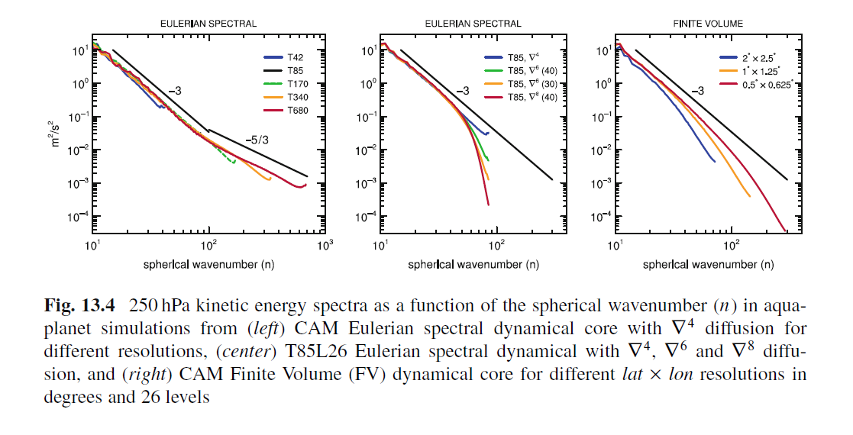
(Jablonowski and Williamson, 2011, Chapter 13)

Slide 3


